Slide 1
Naïve Bayes with Large Vocabularies
Shannon Quinn
(with thanks to William Cohen and Aarti Singh of CMU)

Slide 2
Naïve Bayes: A primer
Anyone remember how this works?

Slide 3
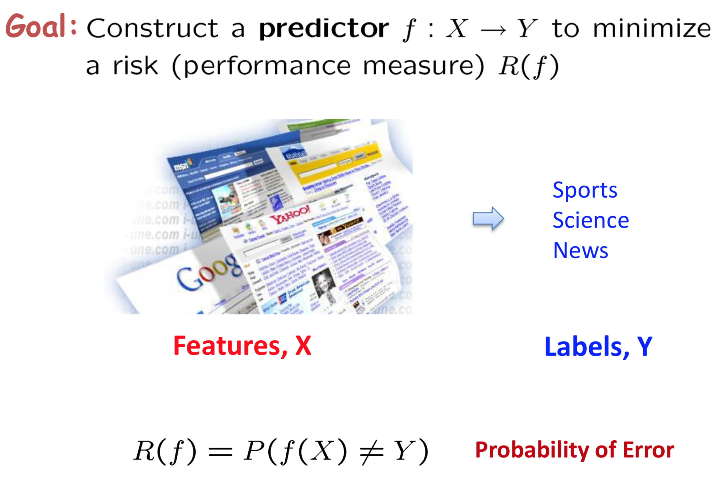
Classification

Slide 4
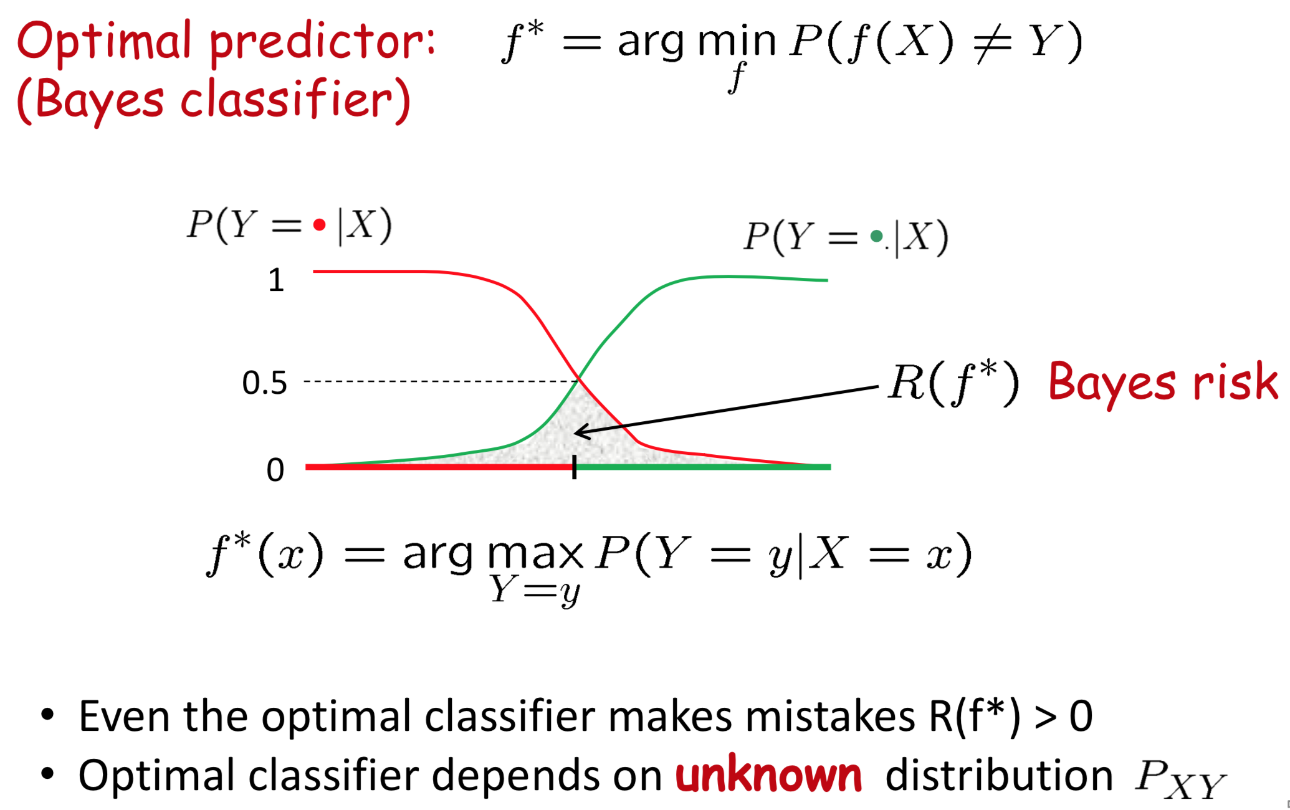
Optimal Classification

Slide 5
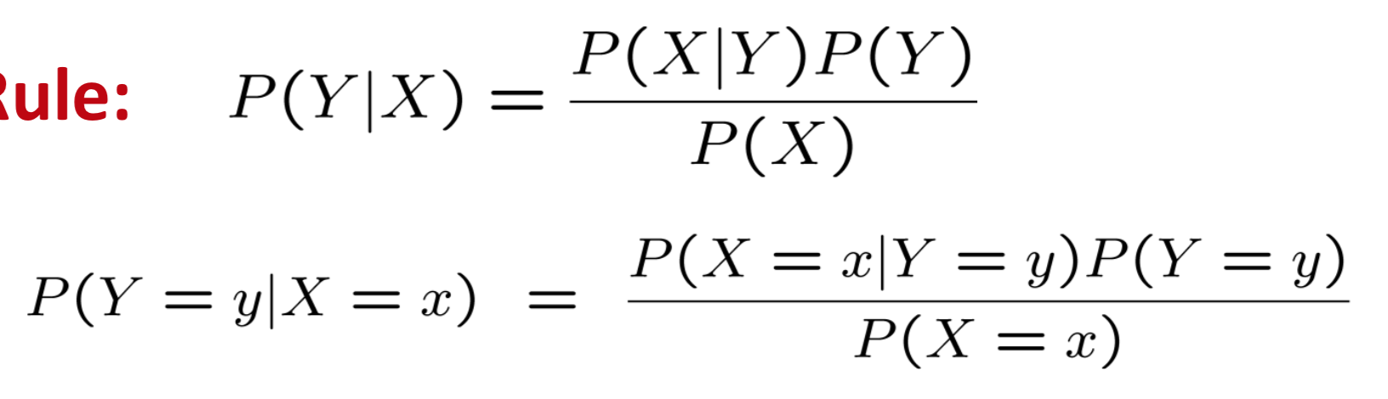
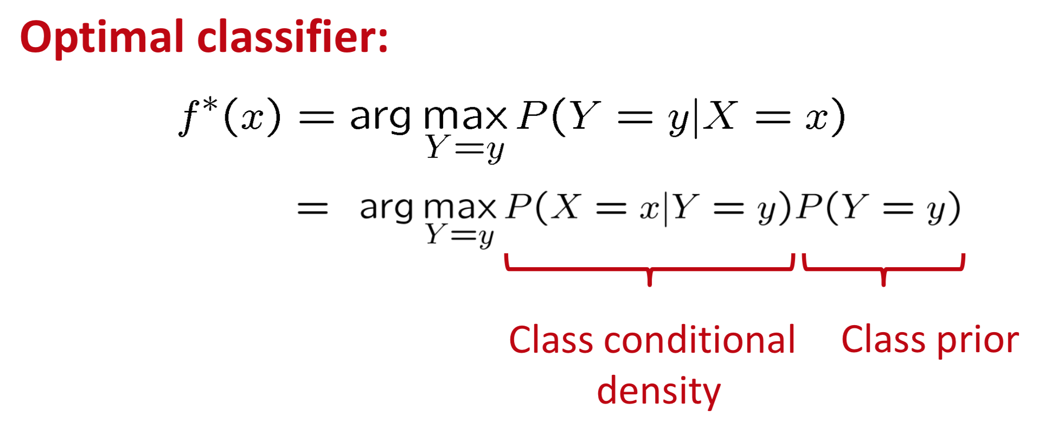
Bayes Rule
Anyone remember?

Slide 6
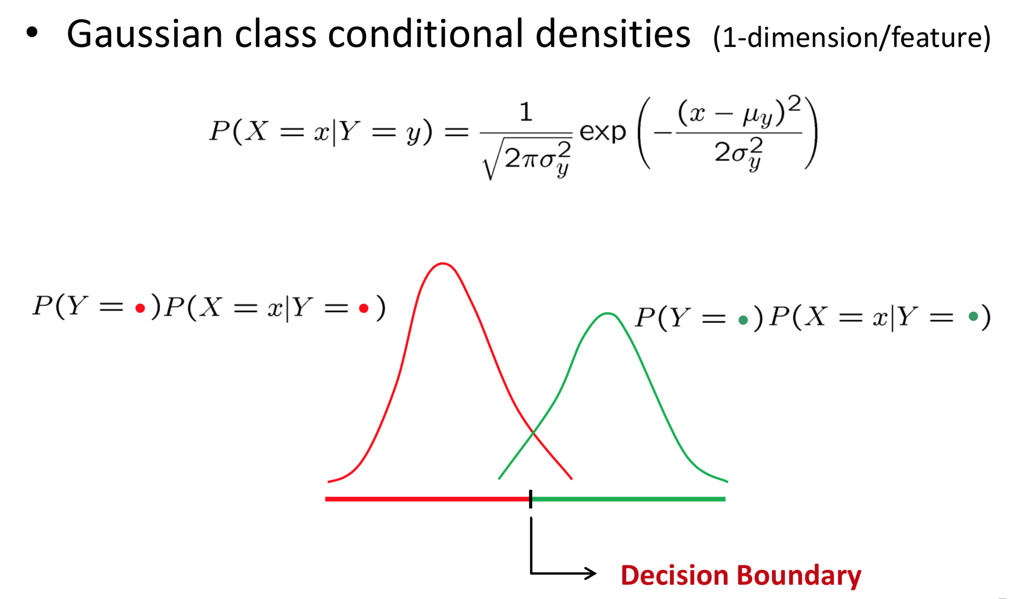
Decision Boundaries

Slide 7
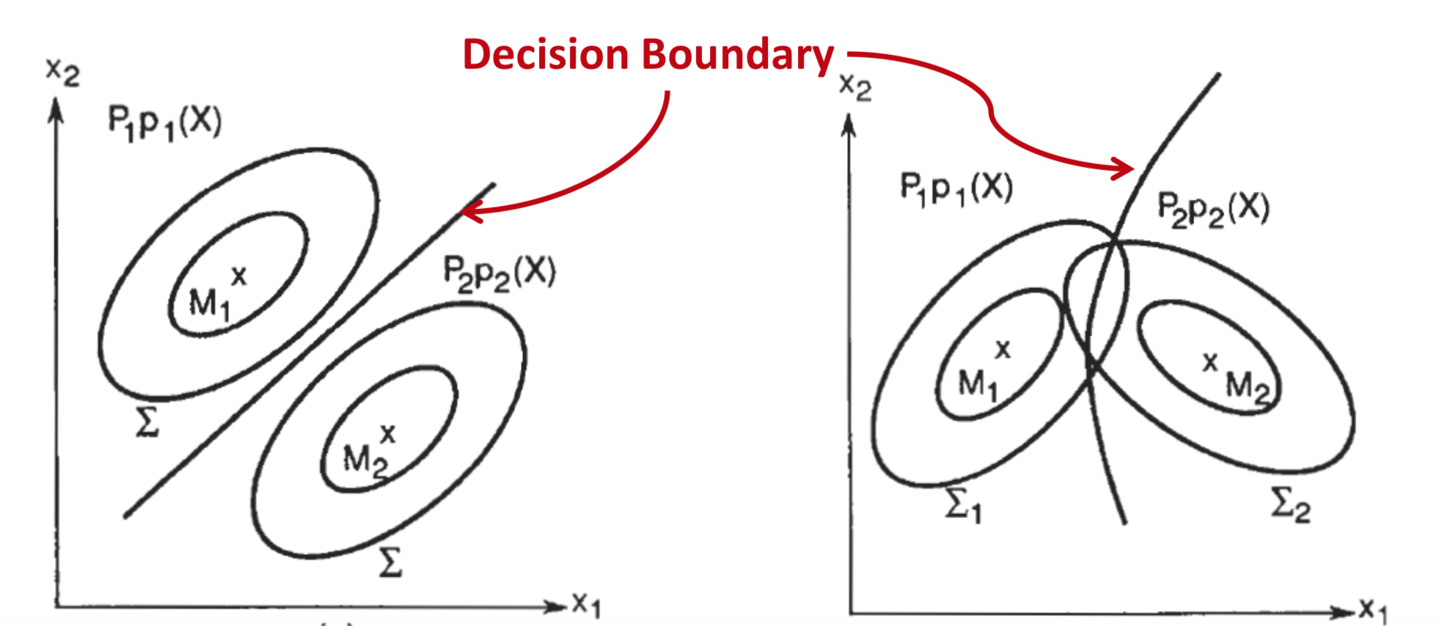

Slide 8
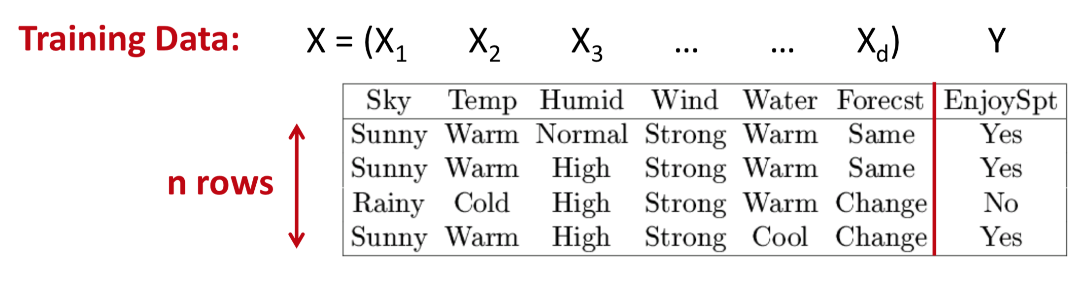


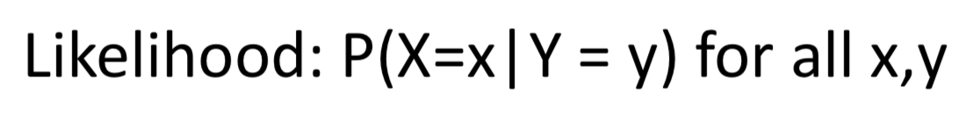

Learning the Optimal Classifier

Slide 9

Curse of dimensionality

Slide 10
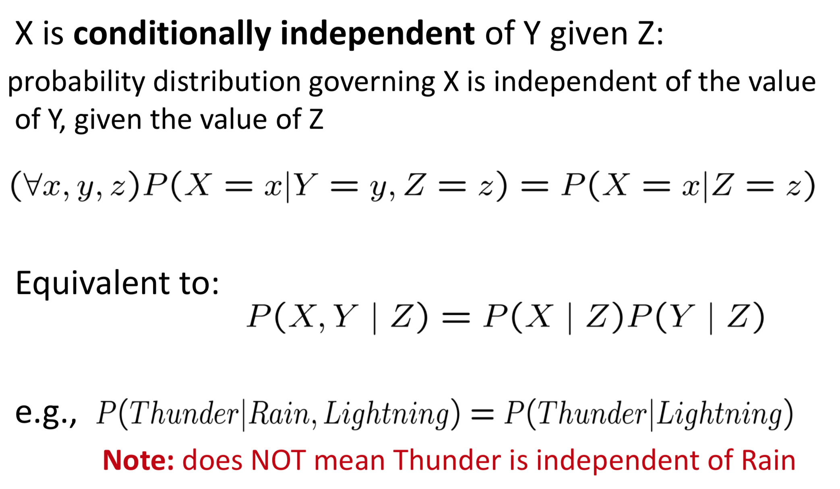
Conditional Independence

Slide 11
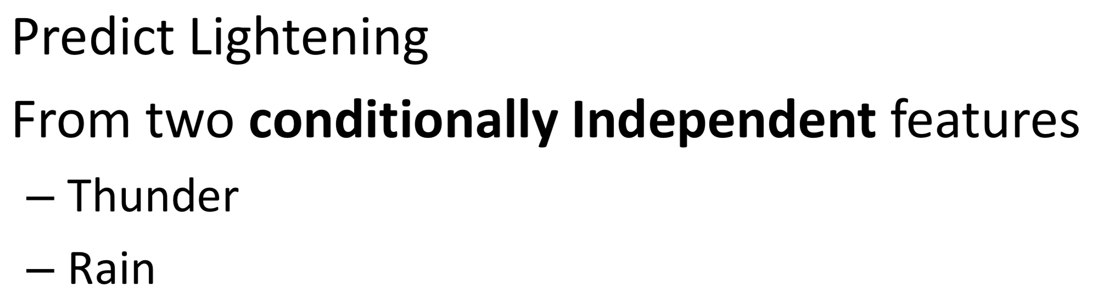
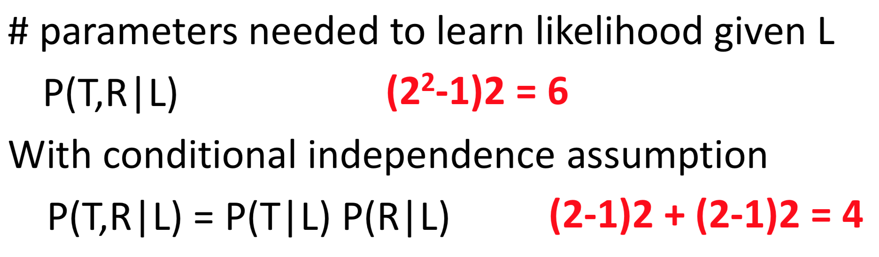
Prediction with Conditional Independence

Slide 12
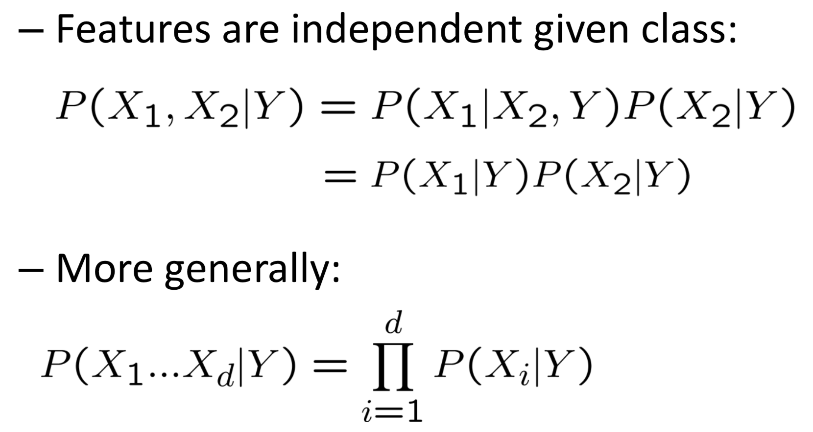
Naïve Bayes Assumption

Slide 13
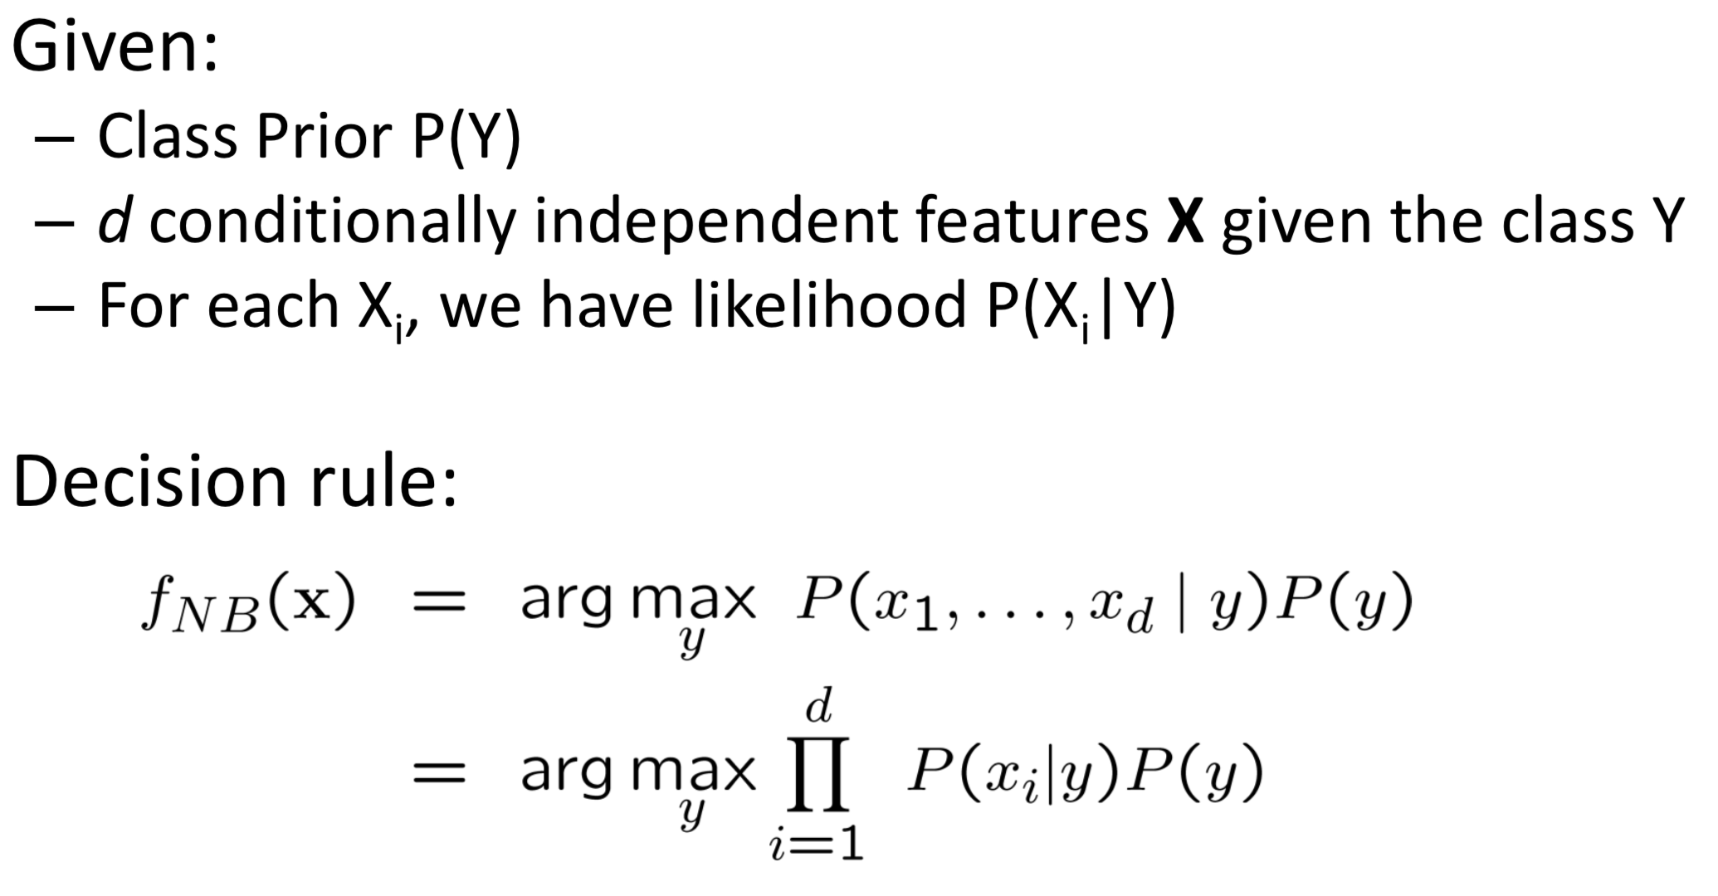
Naïve Bayes Classifier

Slide 14
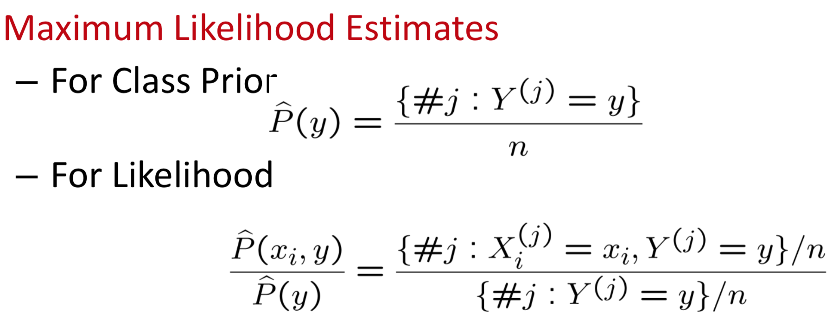
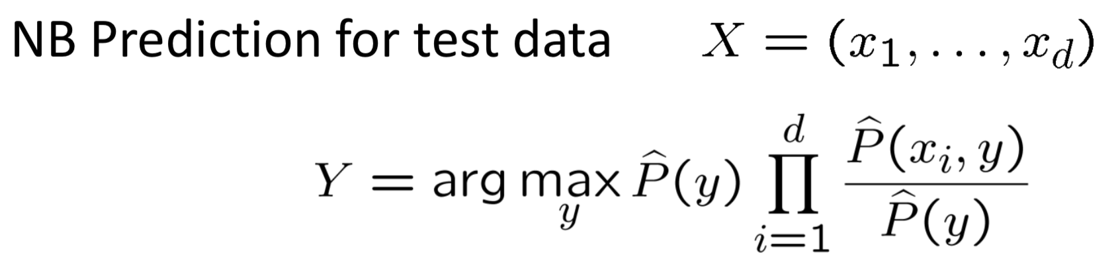
Naïve Bayes Algorithm

Slide 15
So, In our case…

Slide 16

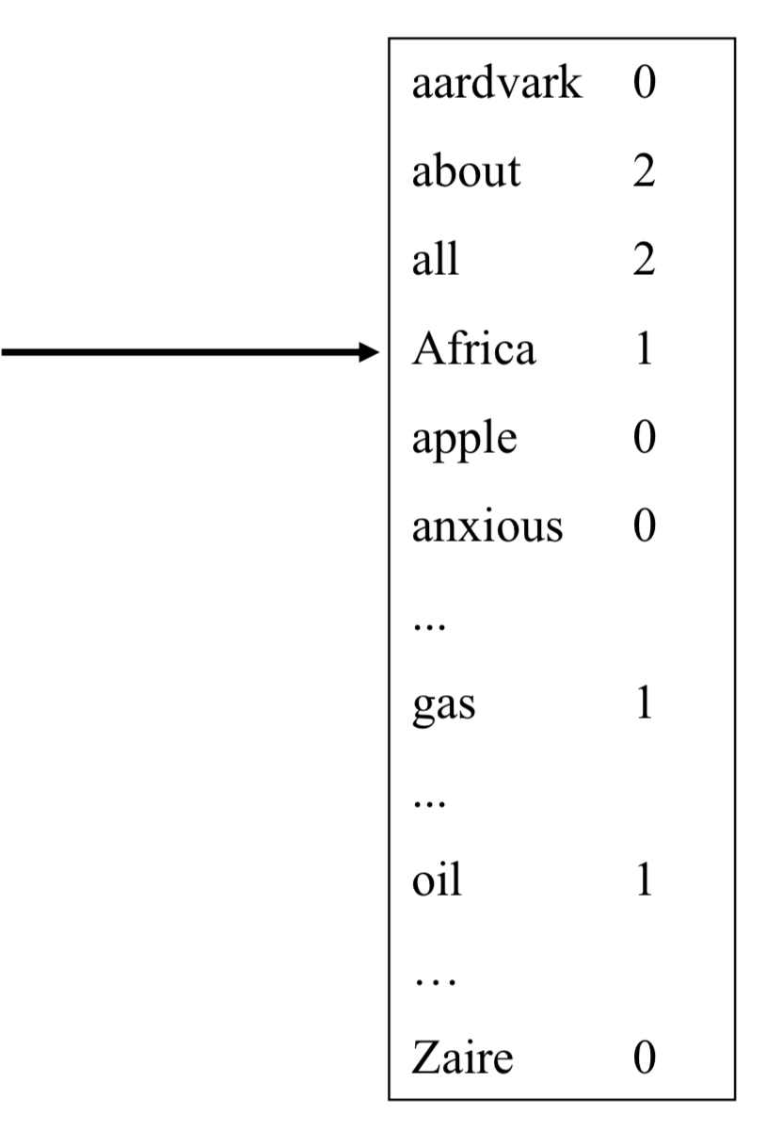
Bag of Words model

Slide 17
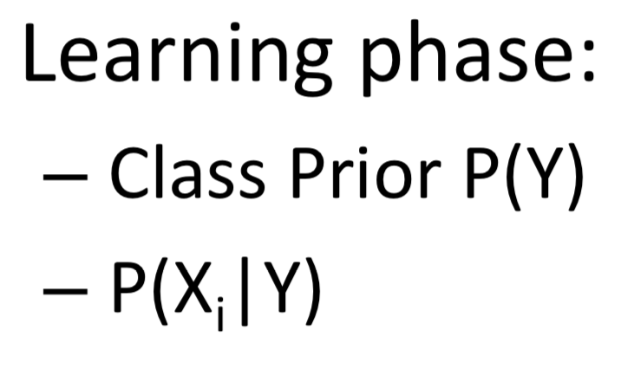
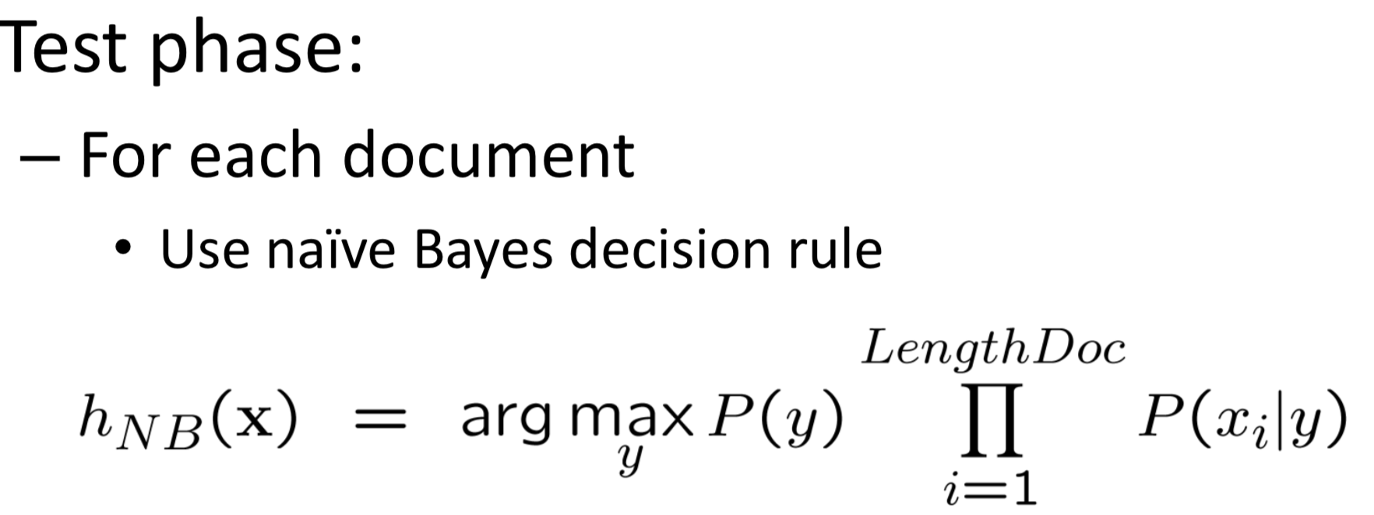
Naïve Bayes for documents

Slide 18
ScaLing To Large Vocabularies: WHY

Slide 19
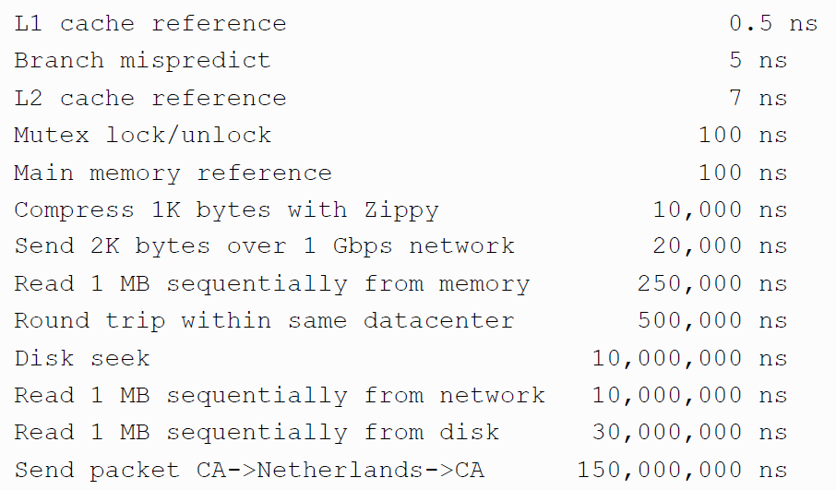
Numbers (Jeff Dean says) Everyone Should Know
~= 10x
~= 15x
40x
~= 100,000x
Notes:
150x – commercial flight vs a brisk walk
100,000x – 5 hr flights would take 57 years
100,000x – 500 miles vs about 8 meters
15,000,000x – here to beijing vs 100 meters

Slide 20

Large Vocabularies
How to implement Naïve Bayes
Assuming the event counters do not fit in memory
Possible approaches:
Use a database? (or at least a key-value store)

Slide 21
Complexity of Naïve Bayes
You have a train dataset and a test dataset
Initialize an “event counter” (hashtable) C
For each example id, y, x₁,….,x_{d} in train:
C(“Y=ANY”) ++; C(“Y=y”) ++
For j in 1..d:
C(“Y=y ^ X=x_{j}”) ++
C(“Y=y ^ X=ANY”) ++
For each example id, y, x₁,….,x_{d} in test:
For each y’ in dom(Y):
Compute log Pr(y’,x₁,….,x_{d}) =
Return the best y’
where:
q_{x} = 1/|V|
q_{y} = 1/|dom(Y)|
m=1

